Slide 1
URINARY ELIMINATION

Slide 2
Elimination is the expulsion of waste products from the body through the skin ,lungs, kidneys and rectum
Urinary elimination is the removal of waste products from the body through the urinary system(urine)
PHYSIOLOGY OF URINARY ELIMINATION
Urinary elimination depends on the effective functioning of the upper urinary tract’s (kidneys and ureters) and the lower urinary tract’s urinary bladder, urethra, and pelvic floor
A pair of kidney situated at either sides of the spinal column behind the peritoneal cavity are the primary regulators of fluid and acid–base balance in the body.
The functional units of the kidneys, the nephrons, filter the blood and remove metabolic wastes. In the average adult 1,200 mL of blood, or about 21% of the cardiac output, passes through the kidneys every minute

Slide 3
Each kidney contains approximately 1 million nephrons. Each nephron has a glomerulus, a tuft of capillaries surrounded by Bowman’s capsule
The endothelium of glomerular capillaries is porous, allowing fluid and solutes to readily move across this membrane into the capsule.
Plasma proteins and blood cells, however, are too large to cross the membrane normally.
Glomerular filtrate is similar in composition to plasma, made up of water, electrolytes, glucose, amino acids, and metabolic wastes.
From Bowman’s capsule the filtrate moves into the tubule of the nephron. In the proximal convoluted tubule, most of the water and electrolytes are reabsorbed. Solutes such as glucose are reabsorbed in the loop of Henle.
Other substances are secreted into the filtrate in the same area, resulting in concentrated urine.
In the distal convoluted tubule, additional water and sodium are reabsorbed under the control of hormones such as antidiuretic hormone (ADH) and aldosterone.

Slide 4
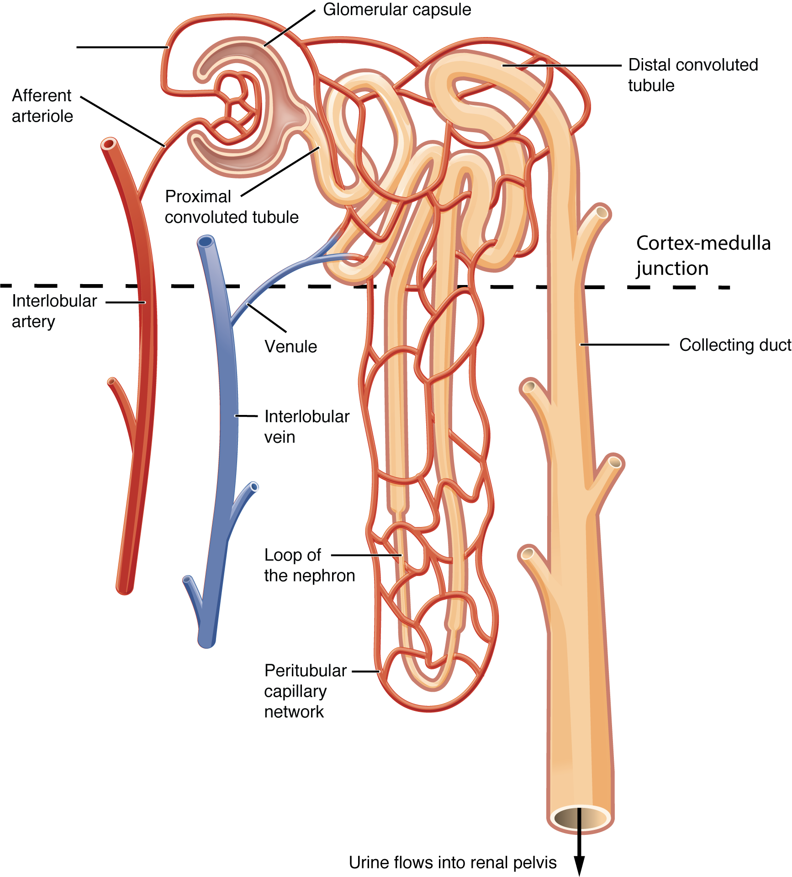

Slide 5
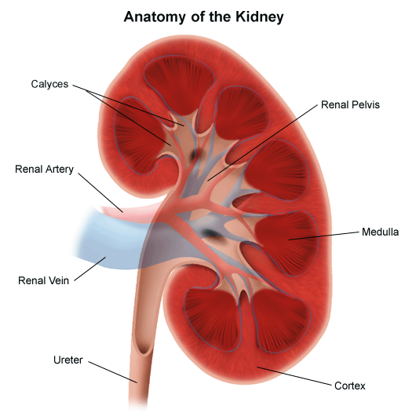

Slide 6
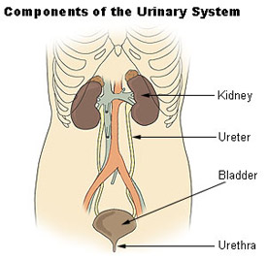

Slide 7
This controlled reabsorption allows regulation of fluid and electrolyte balance in the body.
When fluid intake is low or the concentration of solutes in the blood is high, ADH is released from the posterior pituitary, more water is reabsorbed in the distal tubule, and less urine is excreted.
By contrast, when fluid intake is high or the blood solute concentration is low, ADH is suppressed.
Without ADH, the distal tubule becomes impermeable to water, and more urine is excreted.
When aldosterone is released from the adrenal cortex, sodium and water are reabsorbed in greater quantities, increasing the blood volume and decreasing urinary output.

Slide 8
Ureters
Once the urine is formed in the kidneys, it moves through the collecting ducts into the calyces of the renal pelvis and from there into the ureters.
In adults the ureters are from 25 to 30 cm (10 to 12 in.) long and about 1.25 cm (0.5 in.) in diameter.
The upper end of each ureter is funnel shaped as it enters the kidney. The lower ends of the ureters enter the bladder at the posterior corners of the floor of the bladder
At the junction between the ureter and the bladder, a flaplike fold of mucous membrane acts as a valve to prevent reflux (backflow) of urine up the ureters.

Slide 9
Bladder
The urinary bladder (vesicle) is a hollow, muscular organ that serves as a reservoir for urine and as the organ of excretion.
When empty, it lies behind the symphysis pubis. In men, the bladder lies in front of the rectum and above the prostate gland.
in women it lies in front of the uterus and vagina.
The wall of the bladder is made up of four layers: (1) an inner mucous layer;
(2) a connective tissue layer; (3) three layers of smooth muscle fibers, some of which extend lengthwise, some obliquely, and some more or less circularly; and (4) an outer serous layer. The smooth muscle layers are collectively called the detrusor muscle.
The detrusor muscle allows the bladder to expand as it fills with urine, and to contract to release urine to the outside of the body during voiding.
The trigone at the base of the bladder is a triangular area marked by the ureter openings at the posterior corners and the opening of the urethra at the anterior inferior corner

Slide 10
.
The bladder is capable of considerable distention because of rugae (folds) in the mucous membrane lining and because of the elasticity of its walls.
When full, the dome of the bladder may extend above the symphysis pubis; in extreme situations, it may extend as high as the umbilicus. Normal bladder capacity is between 300 and 600 mL of urine.

Slide 11
Urethra
The urethra extends from the bladder to the urinary meatus (opening). In the adult woman, the urethra lies directly behind the symphysis pubis, anterior to the vagina, and is between 3 and 4 cm (1.5 in.) long .
The urethra serves only as a passageway for the elimination of urine. The urinary meatus is located between the labia minora, in front of the vagina and below the clitoris.
The male urethra is approximately 20 cm (8 in.) long and serves as a passageway for semen as well as urine. The meatus is located at the distal end of the penis.
In both men and women, the urethra has a mucous membrane lining that is continuous with the bladder and the ureters.
Thus, an infection of the urethra can extend through the urinary tract to the kidneys.
Women are particularly prone to urinary tract infections (UTIs) because of their short urethra and the proximity of the urinary meatus to the vagina and anus.

Slide 12
Pelvic Floor
The vagina, urethra, and rectum pass through the pelvic floor, which consists of sheets of muscles and ligaments that provide support to the viscera of the pelvis
These muscles and ligaments extend from the symphysis pubis to the coccyx forming a sling.
Specific sphincter muscles contribute to the continence mechanism .
The internal sphincter muscle situated in the proximal urethra and the bladder neck is composed of smooth muscle under involuntary control. It provides active tension designed to close the urethral lumen.
The external sphincter muscle is composed of skeletal muscle under voluntary control, allowing the individual to choose when urine is eliminated.

Slide 13
Urination
Micturition, voiding, and urination all refer to the process of emptying the urinary bladder. Urine collects in the bladder until pressure stimulates special sensory nerve endings in the bladder wall called stretch receptors.
This occurs when the adult bladder contains between 250 and 450 mL of urine. In children, a considerably smaller volume, 50 to 200 mL, stimulates these nerves.
The stretch receptors transmit impulses to the spinal cord, specifically to the voiding reflex center located at the level of the second to fourth sacral vertebrae, causing the internal sphincter to relax and stimulating the urge to void.
If the time and place are appropriate for urination, the conscious portion of the brain relaxes the external urethral sphincter muscle and urination takes place.
If the time and place are inappropriate, the micturition reflex usually subsides until the bladder becomes more filled and the reflex is stimulated again.

Slide 14
Voluntary control of urination is possible only if the nerves supplying the bladder and urethra, the neural tracts of the cord and brain, and the motor area of the cerebrum are all intact.
The individual must be able to sense that the bladder is full.
Injury to any of these parts of the nervous system for example, by a cerebral hemorrhage or spinal cord injury above the level of the sacral region—results in intermittent involuntary emptying of the bladder.
Older adults whose cognition is impaired may not be aware of the need to urinate or able to respond to this urge by seeking toilet facilities.

Slide 15
FACTORS AFFECTING VOIDING
Numerous factors affect the volume and characteristics of the urine produced and the manner in which it is excreted.
Developmental Factors
INFANTS
Urine output varies according to fluid intake but gradually increases to 250 to 500 mL a day during the first year. An infant may urinate as often as 20 times a day. The urine of the neonate is colorless and odorless and has a specific gravity of 1.008. Because newborns and infants have immature kidneys, they are unable to concentrate urine very effectively.
Infants are born without urinary control. Most will develop this between the ages of 2 and 5 years. Control during the daytime normally precedes night-time control.
PRESCHOOLERS
The preschooler is able to take responsibility for independent toileting. Parents need to realize that accidents do occur and the child should never be punished or disciplined for this. Children often forget to wash their hands or flush the toilet and need instruction in wiping, themselves.
Girls should be taught to wipe from front to back to prevent contamination of the urinary tract by feces.

Slide 16
Nocturnal enuresis, or bed-wetting, is the involuntary passing of urine during sleep. It has many causes but basically it occurs because the client fails to awaken when the bladder empties.
Bed-wetting should not be considered a problem until after the age of 6. Nocturnal enuresis may be referred to as primary when the child has never achieved nighttime urinary control.
The incidence of nocturnal enuresis declines as the child matures. Secondary enuresis is that which appears after the child has achieved dryness for a period of 6 consecutive months.
It is often related to another problem such as constipation, stress, or illness and may resolve when the cause is eliminated.
Recent research indicates that primary and secondary nocturnal enuresis may both be related to poor daytime voiding habits, and children should be taught to be aware of the sensation to void

Slide 17
OLDER ADULTS
The excretory function of the kidney diminishes with age, but usually not significantly below normal levels unless a disease process intervenes. Blood flow can be reduced by arteriosclerosis, impairing renal function.
With age, the number of functioning nephrons decreases to some degree, impairing the kidney’s filtering abilities.
Conditions that alter normal fluid intake and output, such as having influenza or having surgery, can compromise the kidney’s ability to filter, maintain acid–base balance, and maintain electrolyte balance in older adults.
It also takes a much longer time for these processes to return to normal functioning. The decrease in kidney function also places the older adult at higher risk for toxicity from medications if excretion rates are longer.
The more noticeable changes with age are those related to the bladder.
Complaints of urinary urgency and urinary frequency are common. In men these changes are often due to an enlarged prostate gland, and in women they may be due to weakened muscles supporting the bladder or weakness of the urethral sphincter.
The capacity of the bladder and its ability to completely empty diminish with age. This explains the need for older adults to arise during the night to void (nocturnal frequency) and the retention of residual urine, predisposing the older adult to bladder infections.

Slide 18
Psychosocial Factors
For many people, a set of conditions helps stimulate the micturition reflex. These conditions include privacy, normal position, sufficient time, and, occasionally, running water.
Circumstances that do not allow for the client’s accustomed conditions may produce anxiety and muscle tension. As a result, the person is unable to relax abdominal and perineal muscles and the external urethral sphincter; thus, voiding is inhibited.
People also may voluntarily suppress urination because of perceived time pressures; for example, nurses often ignore the urge to void until they are able to take a break. This behavior can increase the risk of UTIs.

Slide 19
Fluid and Food Intake
The healthy body maintains a balance between the amount of fluid ingested and the amount of fluid eliminated.
When the amount of fluid intake increases, therefore, the output normally increases
Certain fluids, such as alcohol, increase fluid output by inhibiting the production of antidiuretic hormone.
Fluids that contain caffeine (e.g., coffee, tea, and cola drinks) also increase urine production.
By contrast, food and fluids high in sodium can cause fluid retention because water is retained to maintain the normal concentration of electrolytes.

Slide 20
Medications
Many medications, particularly those affecting the autonomic nervous system, interfere with the normal urination process and may cause retention.
Diuretics (e.g., chlorothiazide and furosemide) increase urine formation by preventing the reabsorption of water and electrolytes from the tubules of the kidney into the bloodstream.
Some medications may alter the color of the urine.
Muscle Tone
Good muscle tone is important to maintain the stretch and contractility of the detrusor muscle so the bladder can fill adequately and empty completely.
Clients who require a retention catheter for a long period may have poor bladder muscle tone because continuous drainage of urine prevents the bladder from filling and emptying normally.
Pelvic muscle tone also contributes to the ability to store and empty urine.

Slide 21
Pathologic Conditions
Some diseases and pathologies can affect the formation and excretion of urine. Diseases of the kidneys may affect the ability of the nephrons to produce urine.
Abnormal amounts of protein or blood cells may be present in the urine, or the kidneys may virtually stop producing urine altogether, a condition known as renal failure.
Heart and circulatory disorders such as heart failure, shock, or hypertension can affect blood flow to the kidneys, interfering with urine production.
If abnormal amounts of fluid are lost through another route (e.g., vomiting or high fever), the kidneys retain water and urinary output falls.
Processes that interfere with the flow of urine from the kidneys to the urethra affect urinary excretion.
A urinary stone (calculus) some postoperative bleeding; as a result, the urine may be red or pink tinged for a time.
Spinal anesthetics can affect the passage of urine because they decrease the client’s awareness of the need to void. Surgery on structures adjacent to the urinary tract (e.g., the uterus) can also affect voiding because of swelling in the lower abdomen.

Slide 22
ALTERED URINE PRODUCTION
Although people’s patterns of urination are highly individual, most people void about five to six times a day. People usually void when they first awaken in the morning, before they go to bed, and around mealtimes.
Polyuria
Polyuria (or diuresis) refers to the production of abnormally large amounts of urine by the kidneys, often several liters more than the client’s usual daily output.
Polyuria can follow excessive fluid intake, a condition known as polydipsia, or may be associated with diseases such as diabetes mellitus, diabetes insipidus, and chronic nephritis.
Polyuria can cause excessive fluid loss, leading to intense thirst, dehydration, and weight loss.
Oliguria and Anuria
The terms oliguria and anuria are used to describe decreased urinary output. Oliguria is low urine output, usually less than 500 mL a day or 30 mL an hour for an adult.
Although oliguria may occur because of abnormal fluid losses or a lack of fluid intake, it often indicates impaired blood flow to the kidneys or impending renal failure and should be promptly reported to the primary care provider.

Slide 23
Restoring renal blood flow and urinary output promptly can prevent renal failure and its complications.
Anuria refers to a lack of urine production. Should the kidneys become unable to adequately function, some mechanism of filtering the blood is necessary to prevent illness and death.
This filtering is done through the use of renal dialysis, a technique by which fluids and molecules pass through a semipermeable membrane according to the rules of osmosis.
The two most common methods of dialysis are hemodialysis and peritoneal dialysis.
In hemodialysis, the client’s blood flows through vascular catheters, passes by the dialysis solution in an external machine, and then returns to the client.
In peritoneal dialysis, the dialysis solution is instilled into the abdominal cavity through a catheter, allowed to rest there while the fluid and molecules exchange, and then removed through the catheter.
Both hemodialysis and peritoneal dialysis must be performed at frequent intervals until the client’s kidneys can resume the filtering function.

Slide 24
ALTERED URINARY ELIMINATION
Despite normal urine production, a number of factors or conditions can affect urinary elimination.
Frequency, nocturia, urgency, and dysuria often are manifestations of underlying conditions such as a UTI.
Enuresis, incontinence, retention, and neurogenic bladder may be either a manifestation or the primary problem affecting urinary elimination.
Frequency and Nocturia
Urinary frequency is voiding at frequent intervals, that is, more than four to six times per day. An increased intake of fluid causes some increase in the frequency of voiding.
Conditions such as UTI, stress, and pregnancy can cause frequent voiding of small quantities (50 to 100 mL) of urine. Total fluid intake and output may be normal.
Nocturia is voiding two or more times at night. Like frequency, it is usually expressed in terms of the number of times the person gets out of bed to void, for example, “nocturia × 4.”
Urgency
Urgency is the sudden, strong desire to void. There may or may not be a great deal of urine in the bladder, but the person feels a need to void immediately.
Urgency accompanies psychological stress and irritation of the trigone and urethra. It is also common in people who have poor external sphincter control and unstable bladder contractions. It is not a normal finding.

Slide 25
Dysuria
Dysuria means voiding that is either painful or difficult. It can accompany a stricture (decrease in caliber) of the urethra, urinary infections, and injury to the bladder and urethra.
Often clients will say they have to push to void or that burning accompanies or follows voiding.
The burning may be described as severe, like a hot poker, or more subdued, like a sunburn.
Often, urinary hesitancy (a delay and difficulty in initiating voiding) is associated with dysuria’
Enuresis
Enuresis is involuntary urination in children beyond the age when voluntary bladder control is normally acquired, usually 4 or 5 years of age.
Nocturnal enuresis often is irregular in occurrence and affects boys more often than girls. Diurnal (daytime) enuresis may be persistent and pathologic in origin.
It affects women and girls more frequently.

Slide 26
Urinary Incontinence
Urinary incontinence (UI), or involuntary leakage of urine or loss of bladder control, is a health symptom, not a disease. It is only normal in infants. It has been estimated that 20 million women and 6 million men experience some type of UI in their lifetime (Scemons, 2013, p. 53). Shultz (2012) found that 30% of homebound older adults are incontinent, and UI contributed significantly to their being homebound.
The four main types of UI are stress urinary incontinence, urge urinary incontinence, mixed urinary incontinence, and overflow incontinence.
URGE URINARY INCONTINENCE
This type of incontinence is described as an urgent need to void and the inability to stop micturition (passage of urine). The urine leakage can range from a few drops to soaking of undergarments.
Urge incontinence is a major symptom of an overactive bladder

Slide 27
MIXED URINARY INCONTINENCE
Mixed incontinence is diagnosed when symptoms of both stress UI and urgency UI are present. It is very common among middle-age and older women (Scemons, 2013). Treatment is usually based on which type of UI is the most bothersome to the client.
OVERFLOW INCONTINENCE
This is “continuous involuntary leakage or dribbling of urine that occurs with incomplete bladder emptying” (Scemons, 2013, p. 55).
It can be seen in men with an enlarged prostate and clients with a
neurologic disorder (e.g., multiple sclerosis, Parkinson’s disease, spinal
cord injury). An impaired neurologic function can interfere with
the normal mechanisms of urine elimination, resulting in a neurogenic
bladder. The client with a neurogenic bladder does not perceive
bladder fullness and is therefore unable to control the urinary
sphincters. The bladder may become flaccid and distended or spastic,
with frequent involuntary urination.

Slide 28
Urinary Retention
When emptying of the bladder is impaired, urine accumulates and the bladder becomes over distended, a condition known as urinary retention.
Over distention of the bladder causes poor contractility of the detrusor muscle, further impairing urination. Common causes of urinary retention include prostatic hypertrophy (enlargement), surgery, and some medications .
Acute urinary retention is the most common complication in the first 2 to 4 hours postoperatively
Causes of chronic urinary retention can include paraplegia, quadriplegia, multiple sclerosis, and urethral or perineal trauma (Bullman, 2011, p. 259).
Clients with urinary retention may experience overflow incontinence, eliminating 25 to 50 mL of urine at frequent intervals.
The bladder is firm and distended on palpation and may be displaced to one side of the midline.

Slide 29
NURSING MANAGEMENT
Assessing
A complete assessment of a client’s urinary function includes the
following:
• Nursing history
• Physical assessment of the genitourinary system, hydration status, and examination of the urine Relating the data obtained to the results of any diagnostic tests and procedures.

Slide 30
Nursing History
The nurse determines the client’s normal voiding pattern and frequency, appearance of the urine and any recent changes, any past or current problems with urination, the presence of an ostomy, and factors influencing the elimination pattern.
Physical Assessment
Complete physical assessment of the urinary tract usually includes percussion of the kidneys to detect areas of tenderness. Palpation and percussion of the bladder are also performed.
If the client’s history or current problems indicate a need for it, the urethral meatus of both male and female clients is inspected for swelling, discharge, and inflammation.
Because problems with urination can affect the elimination of wastes from the body, it is important for the nurse to assess the skin for color, texture, and tissue turgor as well as the presence of edema.
If incontinence, dribbling, or dysuria is noted in the history, the skin of the perineum should be inspected for irritation because contact with urine can excoriate the skin.

Slide 31
Assessing Urine
Normal urine consists of 96% water and 4% solutes. Organic solutes include urea, ammonia, creatinine, and uric acid.
Urea is the chief organic solute. Inorganic solutes include sodium, chloride, potassium,sulfate, magnesium, and phosphorus.
Sodium chloride is the most abundant inorganic salt. Variations in color can occur.
Measuring Urinary Output
Normally, the kidneys produce urine at a rate of approximately 60 mL/h or about 1,500 mL/day.
Urine output is affected by many factors, including fluid intake, body fluid losses through other routes such as perspiration and breathing or diarrhea, and the cardiovascular and renal status of the individual.
Urine outputs below 30 mL/h may indicate low blood volume or kidney malfunction and must be reported.

Slide 32
To measure fluid output
the nurse follows these steps:• Wear clean gloves to prevent contact with microorganisms or blood in urine. • Ask the client to void in a clean urinal, bedpan, commode, or toilet collection device (“hat”)
Instruct the client to keep urine separate from feces and to avoid putting toilet paper in the urine collection container.
Pour the voided urine into a calibrated container. Hold the container at eye level, read the amount in the container. Containers usually have a measuring scale on the inside.
Record the amount on the fluid intake and output sheet, which may be at the bedside or in the bathroom.
• Rinse the urine collection and measuring containers with cool water and store appropriately.
• Remove gloves and perform hand hygiene.
Calculate and document the total output at the end of each shift and at the end of 24 h on the client’s chart.
Many clients can measure and record their own urine output when the procedure is explained to them.
When measuring urine from a client who has a urinary catheter,

Slide 33
the nurse follows these steps:
Apply clean gloves.
Take the calibrated container to the bedside.
• Place the container under the urine collection bag so that the spout of the bag is above the container but not touching it.
The calibrated container is not sterile, but the inside of the collectionbag is sterile .
Open the spout and permit the urine to flow into the container. Close the spout, then proceed as described in the previous list

Slide 34
Diagnostic Tests
Blood levels of two metabolically produced substances, urea and creatinine, are routinely used to evaluate renal function.
The kidneys through filtration and tubular secretion normally eliminate bothurea and creatinine.
Urea, the end product of protein metabolism, is measured as blood urea nitrogen (BUN). Creatinine is produced in relatively constant quantities by the muscles.
The creatinine clearance test uses 24-hour urine and serum creatinine levels to determine the glomerular filtration rate, a sensitive indicator of renal function.

Slide 35
Diagnosing
NANDA International (Herdman & Kamitsuru, 2014) includes two general diagnostic labels for urinary elimination:
Impaired Urinary Elimination: dysfunction in urine elimination
Readiness for Enhanced Urinary Elimination: a pattern of urinary functions for meeting eliminatory needs, which can be strengthened.
It is suggested that a more specific diagnostic label be used when possible.
The more specific NANDA International nursing diagnoses
related to urinary elimination include the following:
Functional Urinary Incontinence
Overflow Urinary Incontinence
Reflex Urinary Incontinence

Slide 36
Stress Urinary Incontinence
• Urge Urinary Incontinence
• Risk for Urge Urinary Incontinence
• Urinary Retention
Problems of urinary elimination also may become the etiology for other problems experienced by the client. Examples include the following:
• Risk for Infection if the client has urinary retention or undergoes an invasive procedure such as catheterization or cystoscopic examination.
Situational Low Self-Esteem or Social Isolation if the client is incontinent. Incontinence can be physically and emotionally distressing to clients because it is considered socially unacceptable.
Often the client is embarrassed about dribbling or having an accident and may restrict normal activities for this reason.
Risk for Impaired Skin Integrity if the client is incontinent. Bed linens and clothes saturated with urine irritate and macerate the skin.
Prolonged skin dampness leads to dermatitis (inflammation of the skin) and subsequent formation of dermal ulcers.
Toileting Self-Care Deficit if the client has functional incontinence.
Risk for Deficient Fluid Volume or Excess Fluid Volume if the client has impaired urinary function associated with a disease process.

Slide 37
Planning
The goals established will vary according to the diagnosis and defining characteristics. Examples of overall goals for clients with urinary elimination problems may include the following:
Maintain or restore a normal voiding pattern.
Regain normal urine output.
Prevent associated risks such as infection, skin breakdown, fluid and electrolyte imbalance, and lowered self-esteem.
Perform toileting activities independently with or without assistive devices.
Contain urine with the appropriate device, catheter, ostomy appliance, or absorbent product.

Slide 38
Managing Urinary Incontinence
Independent nursing interventions for clients with UI include (a) a behavior-oriented continence training program that may consist of
bladder retraining, habit training, and pelvic floor muscle exercises; (b) meticulous skin care; and (c) for males, application of an external drainage device (condom-type catheter device).
Continence (Bladder) Retraining
A continence retraining program requires the involvement of the nurse, the client, and support people. Clients must be alert and physically able to participate in the training protocol.
A bladder retraining program may include the following:
• Education of the client and support people.
• Bladder retraining, which requires that the client postpone voiding, resist or inhibit the sensation of urgency, and void according to a timetable rather than according to the urge to void. The goals are

Slide 39
to gradually lengthen the intervals between urination to correct the client’s frequent urination, to stabilize the bladder, and to diminish urgency.
This form of training may be used for clients who have bladder instability and urge incontinence.
Delayed voiding provides larger voided volumes and longer intervals between voiding. Initially, voiding may be encouraged every 2 to 3 hours except during sleep and then every 4 to 6 hours.
A vital component of bladder training is inhibiting the urge-to-void sensation. To do this, the nurse instructs the client to practice deep, slow breathing until the urge diminishes or disappears.
This is performed every time the client has a premature urge to void.
• Habit training, also referred to as scheduled toileting, attempts to keep clients dry by having them void at regular intervals, such as every 2 to 4 hours.
The goal is to keep the client dry and is a common therapy for frail older clients and those who are bedridden or have Alzheimer’s disease (NAFC, 2013).

Slide 40
Pelvic Floor Muscle Exercises
Pelvic floor muscle (PFM), or Kegel, exercises help to strengthen
pelvic floor muscles (see Figures 48–3 and 48–4) and can reduce or
eliminate episodes of incontinence. The client can identify the perineal
muscles by tightening the anal sphincter as if to control the passing
of gas or to hold a bowel movement.
Keyock and Newman (2011) describe two types of muscle contractions
to practice PFM. One is a quick 2-second contraction where
the client squeezes the pelvic muscle quickly and hard and then relaxes
immediately. The other is a slow 3- , 5-, or 10-second long contraction.
The pelvic muscle is relaxed after the sustained contraction.
The client gradually builds up to the 10-second sustained contraction.
When the exercise is properly performed, contraction of the
muscles of the buttocks and thighs is avoided. PFM can be performed
anytime, anywhere, sitting or standing. Specific client instructions for
performing PFM are summarized in Client Teaching.

Slide 41
Maintaining Skin Integrity
Skin that is continually moist becomes macerated (softened). Urine that accumulates on the skin is converted to ammonia, which is veryirritating to the skin.
Because both skin irritation and maceration predispose the client to skin breakdown and ulceration, the incontinent person requires meticulous skin care.
To maintain skin integrity, the nurse washes the client’s perineal area with mild soap and water or a commercially prepared no-rinse cleanser after episodes of incontinence.
The nurse then rinses the area thoroughly if soap and water were used, and dries it gently and thoroughly.
Clean, dry clothing or bed linen should be provided. The nurse applies barrier ointments or creams to protect the skin from contact with urine.
If it is necessary to pad the client’s clothes for protection, the nurse should use products
that absorb wetness and leave a dry surface in contact with the skin.

Slide 42
Applying External Urinary Draining Devices
The application of a condom or external catheter connected to a urinary drainage system can be used for incontinent males.
Use of a condom appliance is preferable to insertion of a retention catheter because the risk of UTI is minimal.

Slide 43
Managing Urinary Retention
Interventions that assist the client to maintain a normal voiding pattern, discussed earlier, also apply when dealing with urinary retention.
If these actions are unsuccessful, the primary care provider may order a cholinergic drug such as bethanechol chloride (Urecholine) to stimulate bladder contraction and facilitate voiding.
Clients who have a flaccid bladder (weak, soft, and lax bladder muscles) may use manual pressure on the bladder to promote bladder emptying. This is known as Credé’s maneuver or Credé’s method. It is not advised
without a primary care provider or nurse practitioner’s order and is used only for clients who have lost and are not expected to regain voluntary bladder control.
When all measures fail to initiate voiding, urinary catheterization may be necessary to empty the bladder completely.
An indwelling Foley catheter may be inserted until the underlying cause is treated. Alternatively, intermittent straight catheterization (every 3 to 4 hours) may be performed because the risk ofUTI may be less than with an indwelling catheter.

Slide 44
Urinary Catheterization
Urinary catheterization is the introduction of a catheter into the urinary bladder. This is usually performed only when absolutely necessary, because the danger exists of introducing microorganisms into the bladder.
The most frequent health care–associated infection is a UTI, and indwelling urethral catheters cause 80% of these UTIs (Institute for Healthcare Improvement [IHI], 2011). A catheter-associated
urinary tract infection (CAUTI) is a “urinary tract infection that occurs while an indwelling catheter is in place or within 48 hours of its removal” (Seckel, 2013, p. 63).
Clients with a CAUTI remain in the hospital longer and need to be placed on antibiotic therapy, which increases health care costs.
The high incidence and high costs related to CAUTI, in addition to the fact that most are preventable, resulted in the Centers for Medicare and Medicaid Services (CMS) not reimbursing
hospitals unless the CAUTI was documented as present

